Slide 1
Edinburgh Business School MBA
Strategic Planning
Module 2
Modeling the Strategic Planning
Process
Instructor: Moataz Darwish, MBA

Slide 2
Contents
The Modeling Approach
  The Components of a Model
  Benefits and Costs of the Modeling Approach
  A Functional Model
Strategy Making

Slide 3
The Modeling Approach
A model is a structured method of thinking.
  Enables the component parts of complex processes to be identified and related to each other;
  Does not imply that the process of strategic planning occurs in individual companies exactly as described by a model.
  No model can describe a process exactly;
A strategic planning model is an attempt to rationalize the complex processes of company decision making where the connection between cause and effect is obscure.
Strategic planning model can take various forms.
The power of the modeling approach lies in simplifying and making understandable what at first sight appears to be impenetrable;

Slide 4
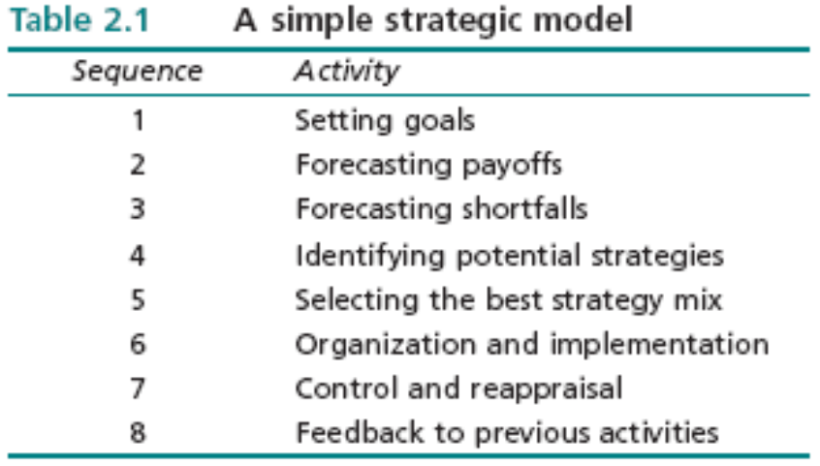
The Modeling Approach
The Components of a Model
The simple strategic planning model shown in Table 2.1 represents planning as a flow process.
Enablers & Barriers;
Strategy Options / Choice
Resource allocation
Monitoring

Slide 5
The Modeling Approach
The Components of a Model
The model attempts to extract ‘a pattern in a stream of decisions’.
  Criticism:
    No insight into real life processes.
    Forecasting must precede the setting of goals as it is impossible to set goals without some sort of prediction.
  Counter argument:
    Identifies the main components of the strategic planning process,
    Attention should be paid to the order in which different tasks are tackled,
    Provides a structure for discussing strategy issues
    Providing the basis for a check that the necessary steps have been carried out prior to committing the company to a course of action.
    Takes into account that the process is dynamic and feeds back on itself,
    one view is that feedback is the most important element in the strategic planning process,
    Means by which the organization learns by experience.

Slide 6
The Modeling Approach
The Components of a Model
The feedback process is crucial to understanding the role of the model.
The ‘learning organization’
Logical incrementalizm’
  Company can only start with certain strategic thrusts in mind, which are general notions of what should be done in the future,
  Notions are refined as time progresses in an iterative fashion.

Slide 7
The Modeling Approach
Benefits and Costs of the Modeling Approach
Benefits
  Provides a structure
  Simplifies complex processes
  Acts as a check list
  Identifies areas of disagreement
Costs
  Imparts a mechanistic impression to the process
  Introduces rigidity to a dynamic process
  Gives impression that strategy can be derived from a model

Slide 8
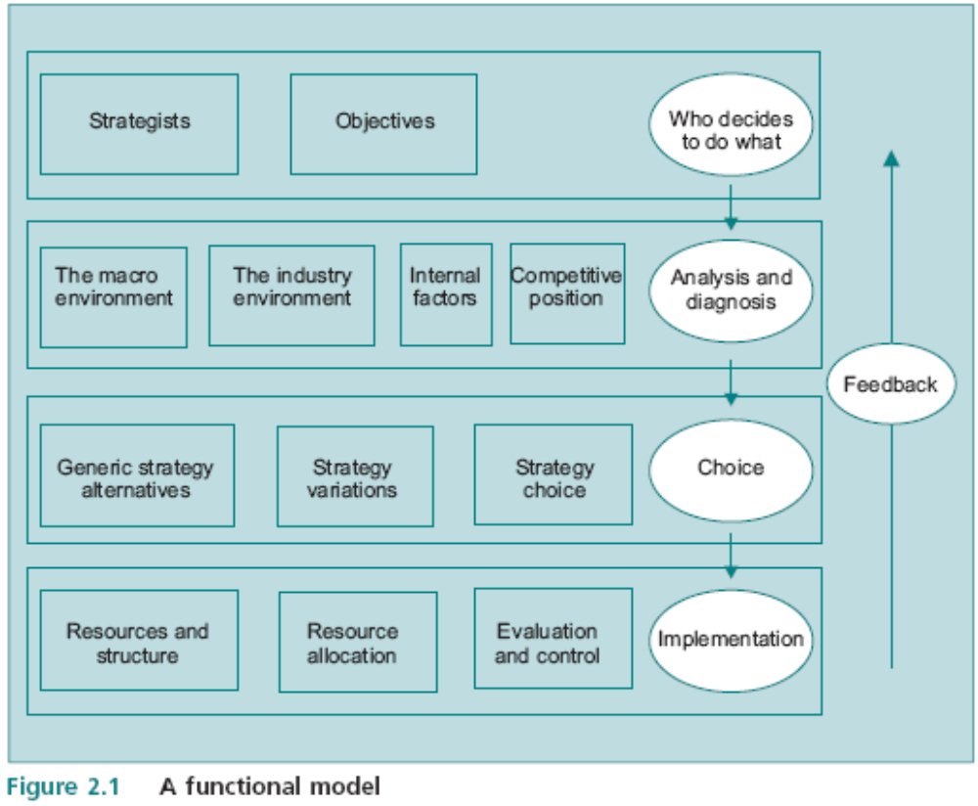
The Modeling Approach
A Functional Model
4 rows
5 eggs
12 boxes
The General Pattern:
What to do
Finding different ways
Selecting one
Tracking outcomes
Keep options open

Slide 9
Contents
The Modeling Approach
Strategy Making
  Strategy and the Evolution of the Company
  Strategists

Slide 10
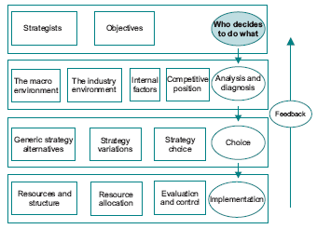
Strategy Making
Who decides to do what
  Individuals?
  Organizations?

Slide 11
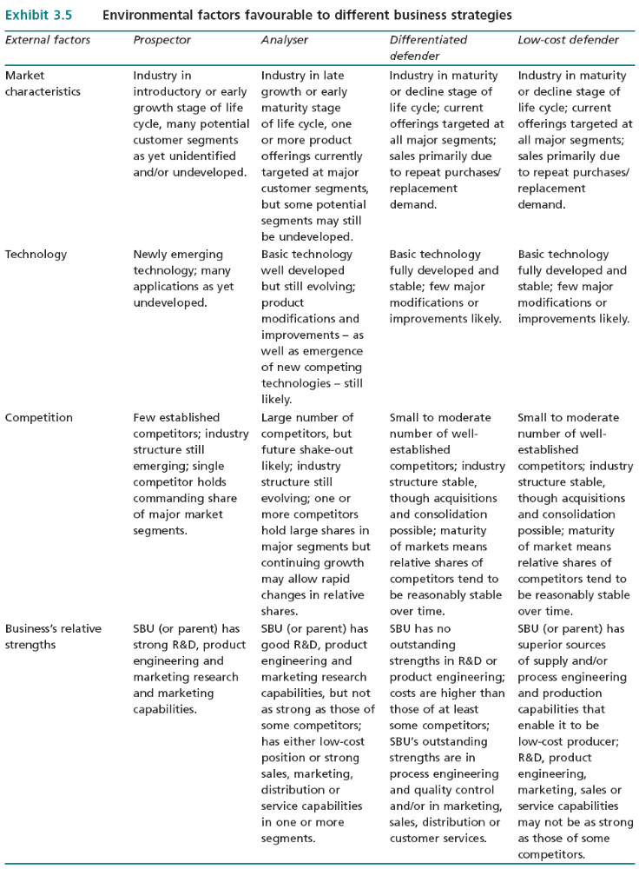
Who decides to do what
  Prospector
  Analyzer
  Defender
  Reactor
Reference: EBS Marketing Text book.

Slide 12
Strategy Making
The value which companies place on leadership can be very high:
  Asda chain - Archie Norman;
  GEC – George Simpson
  Virgin - Richard Branson,

Slide 13
Strategy Making
Different individuals have different objectives, view the same information in different ways, and often act differently depending on the decision making environment.
If the setting of objectives is not systematic, is there any point in attempting to be systematic about meeting these objectives?
  they are the only ones we have!

Slide 14
Strategy Making
Strategy and the Evolution of the Company
The typical company is continuously evolving,
The roles undertaken by decision makers are to some extent dependent on the stage of the company’s evolution,
Can be classified in three stages:
  the small single product company,
  the integrated company,
  the large diversified company.

Slide 15
Strategy Making
Strategy and the Evolution of the Company
Small or Entrepreneurial - controlled by the owner-manager.
Integrated company:
  - owner manager still retains control over strategic decisions,
  - but most operating decisions are delegated through policy.
large diversified company:
  formalized managerial systems
  Product and market decisions are delegated to the heads of SBUs.

Slide 16
Strategy Making
Strategy and the Evolution of the Company
In smaller companies the individual owner plays a dominant role in determining strategy,
But in the larger, diversified company it may be difficult to identify strategists.
  ownership and control tend to be differentiated,
  shareholders rather than to individual owners
  tendency for bureaucratic procedures
  ability to undertake radical innovation is hindered - IBM

Slide 17
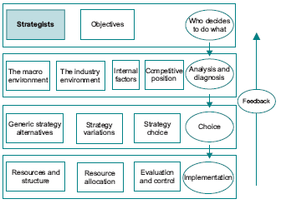
Strategy Making
Strategists
It is often difficult to identify the ‘ultimate’ strategic planner in companies which have developed beyond the stage of owner/manager control.

Slide 18
Strategy Making
Strategists
How managers actually spend their time?
Research has produced some information about what managers actually do, it has been unable to identify causal relationships between behavior and outcomes.
Since the activities of managers cannot be readily classified and fitted into a model of behavior, the precise role of different managers in the strategic planning process is not subject to hard and fast rules.
The four ‘eggs’ on the right hand side of the process model serve to identify several roles.
There is also a degree of conflict inherent in the different roles.
  Efficiency vs. Effectiveness
  Mission, Objectives vs. Controls, Rewards

Slide 19
Extra Slides (Not in Text Book)

Slide 20
Corporate Governance - Definition
'an internal system encompassing policies, processes and people, which serves the needs of shareholders and other stakeholders, by directing and controlling management activities with good business savvy, objectivity, accountability and integrity. Sound corporate governance is reliant on external marketplace commitment and legislation, plus a healthy board culture which safeguards policies and processes'.
Business author Gabrielle O'Donovan

Slide 21
Corporate Governance
Corporate governance is the set of processes, customs, policies, laws, and institutions affecting the way a corporation is directed, administered or controlled.
Corporate governance also includes the relationships among the many stakeholders involved and the goals for which the corporation is governed.
The principal stakeholders are:
  The shareholders, management, and the Board of Directors.
  Other stakeholders include: Labor (employees), customers, creditors (e.g., banks, bond holders), suppliers, regulators, and the community at large.
  Ex. Enron and Worldcom
  Sarbanes-Oxley Act
    Code of Ethics
    Audit, Nominating, and Compensation Committees all outside directors

